Slide 1
Decode the ENCODE
Characterization, and Beyond

Slide 2
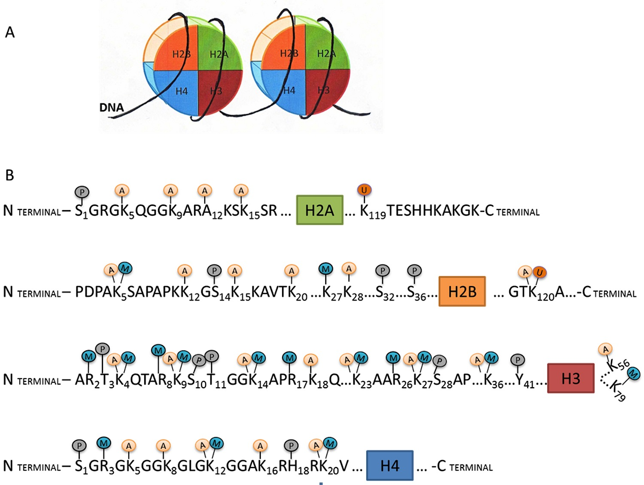
Epigenetic, transcriptional, and post-transcriptional regulation
Notes:
This graph shows the big picture of gene regulation. From right to the left. Firstly, genome is modified with epigenetic regulations by chromatin and histone binding proteins. Then, a group of transcription factors and RNA polymerases actually initiate gene transcription. This is followed by post-transcriptional regulation, including splicing and addition of polyA tail.
Histone modification is the most studied form of epigenetic regulation. Histone is the core protein of nucleosome, which is composed of four histone subfamilies: H2A, H2B, H3 and H4, in which H3 and H4 have long tails protruding from the nucleosome and histone modification happens on this tail at several places. Modifications of the tail include methylation, acetylation, phosphorylation, and ubiquitination. H3k4me1 represents mono-methylation of the 4th place of the tail of H3, which is a lysine.

Slide 3
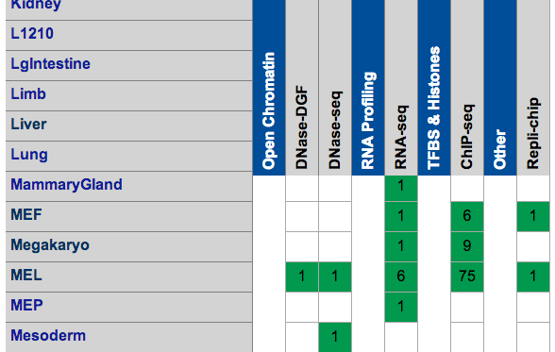
Mouse ENCODE
The goal of ENCODE is to build a comprehensive list of functional elements in the human genome, with pilot projects in model organisms, including mouse, Drosophila, C elegans.
 | RNA | H3k4me1, H3k4me3, H3k9ac, H3k9me3, H3k27ac, H3k27me3, H3k36me3, CTCF, Polr2a, P300
Cerebellum | UCSD-REN Adult 8 weeks
ES-Bruce4 | UCSD-REN Embryonic day 0
Heart | UCSD-REN Adult 8 weeks
Kidney | UCSD-REN Adult 8 weeks
Liver | UCSD-REN Adult 8 weeks
MEL | UCSD-REN
Intestine | UCSD-REN Adult 8 weeks
Spleen | UCSD-REN Adult 8 weeks
Testis | UCSD-REN Adult 8 weeks
Thymus | UCSD-REN Adult 8 weeks
Brain | UCSD-REN Embryonic day 14.5

Slide 4
Hypothesis
M
M
M
GENE
0 0 0 0 1 0 0 0 1 1 1 0 1 1 1 0 1 0
Binary genome in 200bp unit
Notes:
My question is two fold: 1, how individual mark affects gene expression; 2, how different marks interact with each other and affect gene expression.

Slide 5

Epigenomic and genetic integration
M
M
M
M
M
M
M
Promoter
5′ UTR
EXON
EXON
3′ UTR
 | Genetic regions
 | TSS 1K, Promoter 2K, Promoter 5K, Transcript, Exon, Intron, 5UTR, 3UTR, Enhancer (9)
 | Histone marks and Transcription factors
 | H3k4me1, H3k4me3, H3k9ac, H3k9me3, H3k27ac, H3k27me3, H3k36me3, CTCF, Pol2, P300, Active Enhancer, Inactive Enhancer (12)
 | Epigenomic features of given mark in given genetic regions
 | Length of coverage, number of peaks, coverage intensity, signal of the peaks (4)
Notes:
First row of this graph shows the raw data of a epigenomic mark from a chip-seq experiment. The question is what aspects of these peaks are important for gene regulation?

Slide 6
H3k36me3 in ES-Bruce4 (mouse embryotic stem cell)

Slide 7
Relative with genetic features (ES-B4)

Slide 8
Relative with genetic features (Liver)

Slide 9
Enrichment in genetic features (ES-B4)

Slide 10
Enrichment in genetic features (Liver)

Slide 11
Single feature correlation (ESB4)

Slide 12
Single feature correlation (Liver)

Slide 13
Significant interactive features (ESB4)
FDR corrected p value for interactive terms less than 0.05.
Effect size for interactive terms more than 1 (absolute value).
Interaction between different marks

Slide 14
Significant interactive features (Liver)
FDR corrected p value for interactive terms less than 0.05.
Effect size for interactive terms more than 1 (absolute value).
Interaction between different marks

Slide 15
Potentially important interactions (ESB4)

Slide 16
Potentially important interactions (Liver)

Slide 17
Effect sizes of models

Slide 18
Interactions
Notes:
This picture shows the damage of Alzheimer’s disease on the brain.

Slide 19
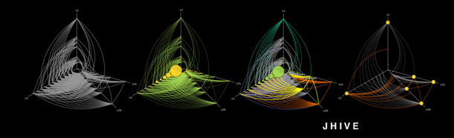
JHIVE
Notes:
This picture shows the damage of Alzheimer’s disease on the brain.

Slide 20
Plan
Different samples in mouse ENCODE
Human samples

Slide 21
Decode the ENCODE
Characterization, and Beyond

Slide 22
Step forward AIC

Slide 23
What to accomplish?
The best model or models to predict gene expression??

